Slide 1
Visual Analytics– Visualization 101
Dr. Ab Mosca (they/them)
Slides based off slides courtesy of Jordan Crouser (https://jcrouser.github.io/)

Slide 2
Plan for Today
Visualization overview
Graphical primitives
Visual dimensions
Common visualization techniques
Time permitting: Tableau demo

Slide 3
Reminder
hw01 is released today! (https://amosca01.github.io/SDS-CS235/ > Homework > hw01)
Due next Thursday (09/19) at midnight
You have extensions if you need them, but you MUST tell me if you’re taking one
Revise and resubmit also exists!
Work alone or with a partner (you choose!)
**I won’t always remind you there is a homework released/due, make sure you stay up to date with the course schedule! **

Slide 4
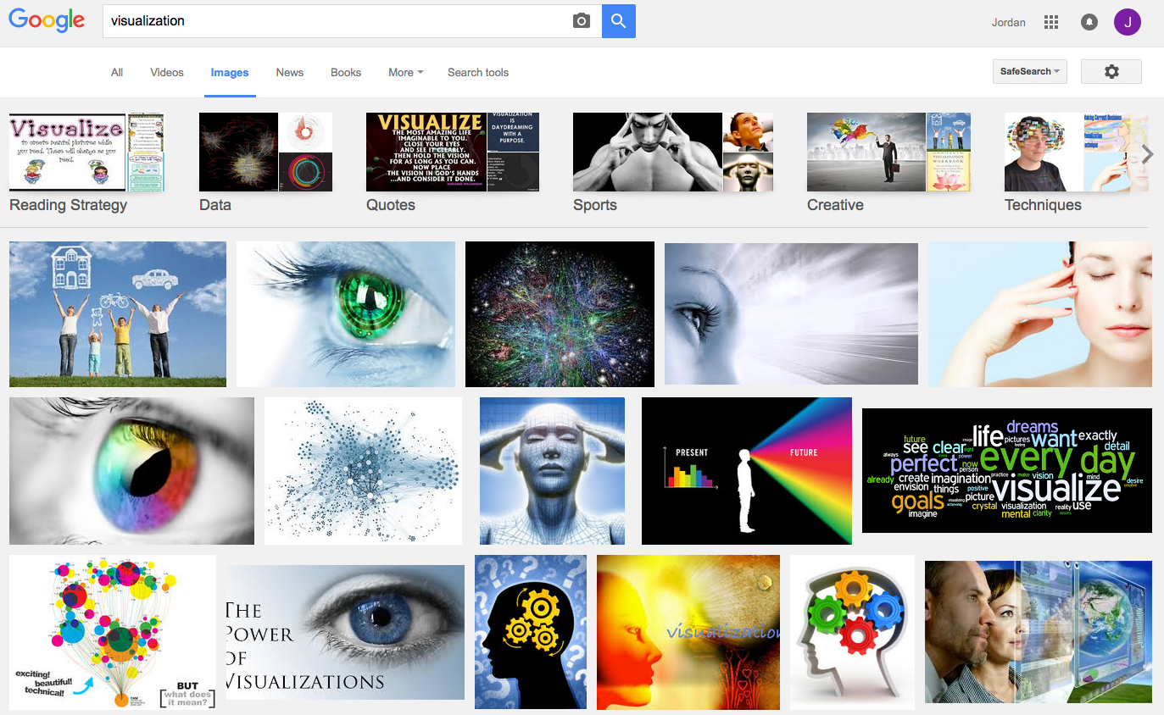
What is visualization?

Slide 5
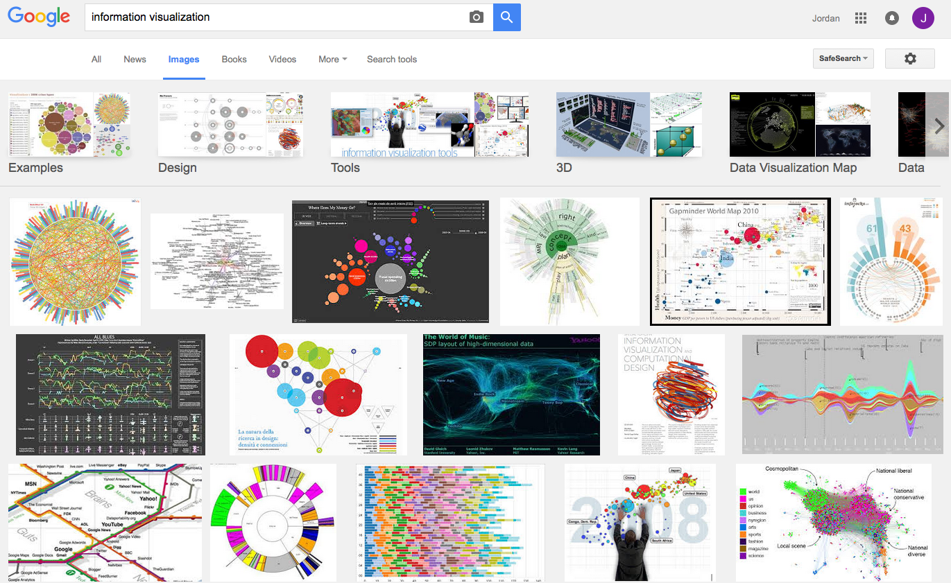
What is visualization?

Slide 6
Perhaps a more helpful question:
What are some ways
a “visualization” can be useful?

Slide 7
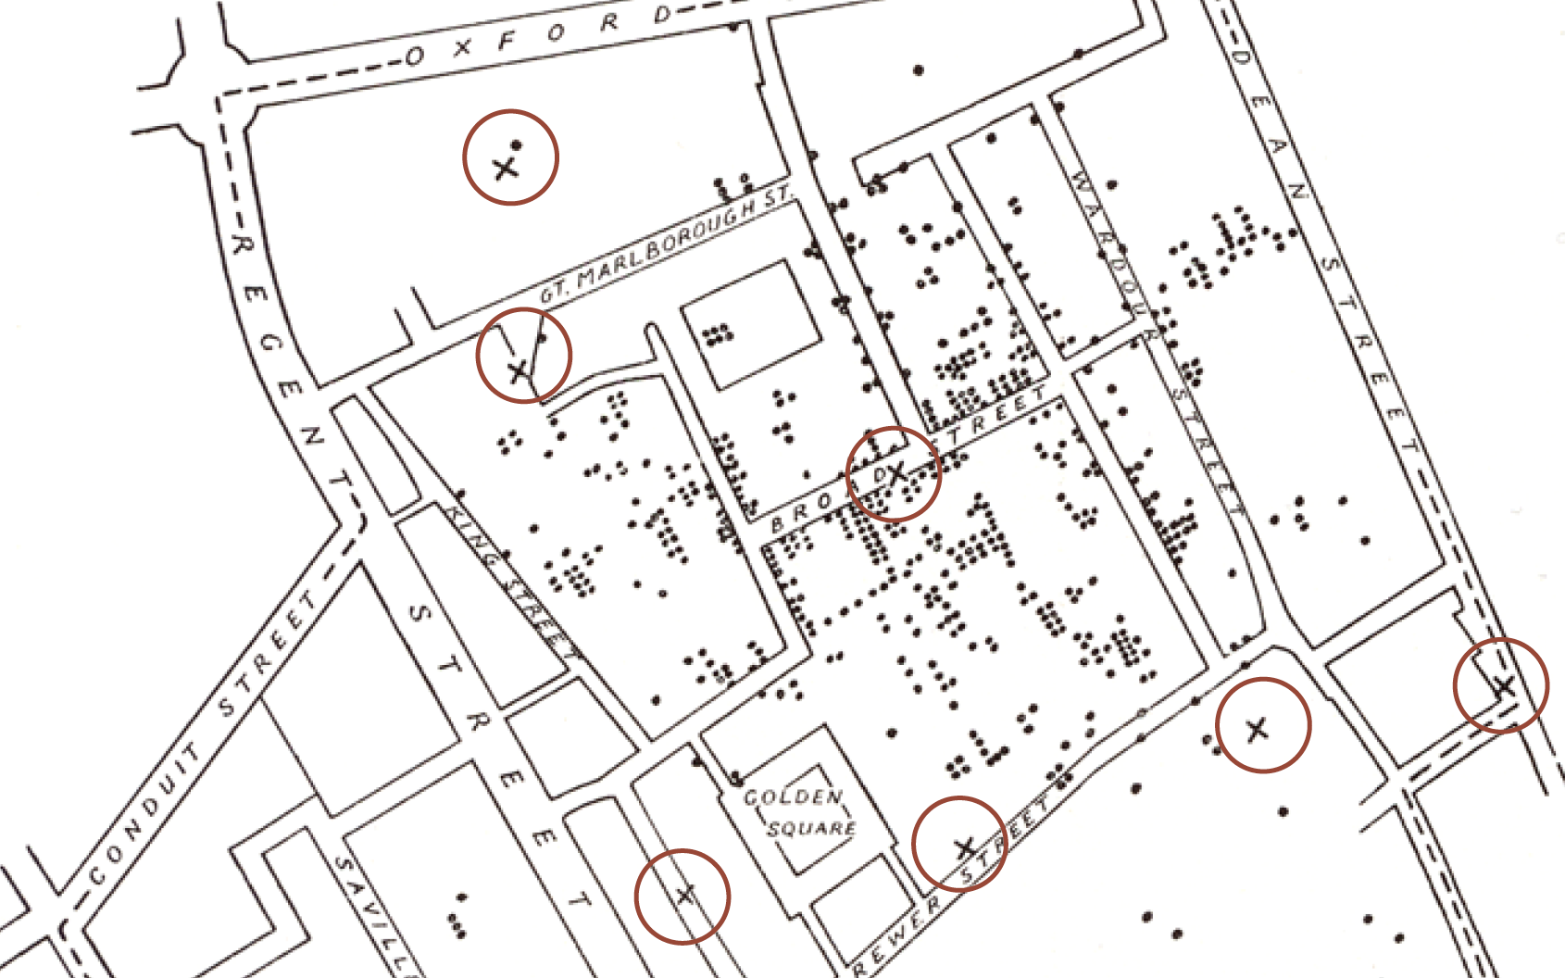
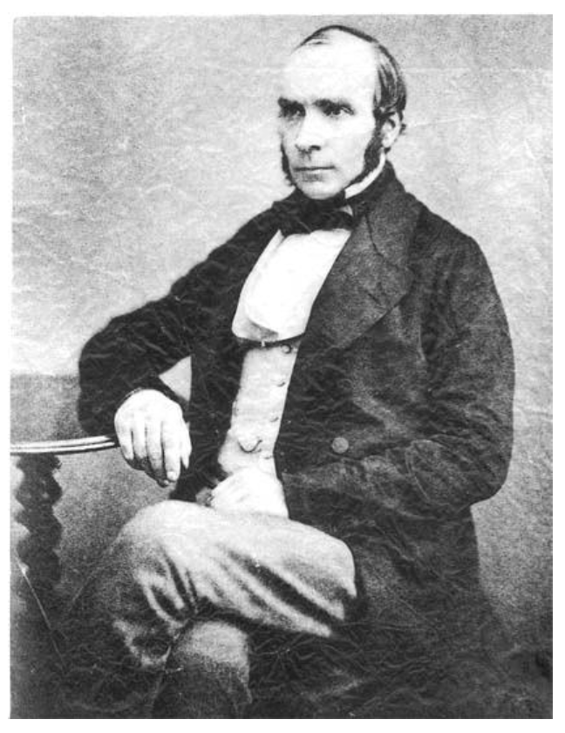
Does it help you spot trends?
In 1854, cholera broke out in London
127 people near Broad St. died within 3 days
616 people died within 30 days
Initial explanation:
“Miasma in the atmosphere”
Dr. John Snow was the first to link the outbreak to contaminated water
How did he do it?
Talked to local residents
Identified a water pump as a likely source
Used maps to illustrate his theory
Convinced authorities to disable the pump
More info here: http://en.wikipedia.org/wiki/1854_Broad_Street_cholera_outbreak

Slide 8
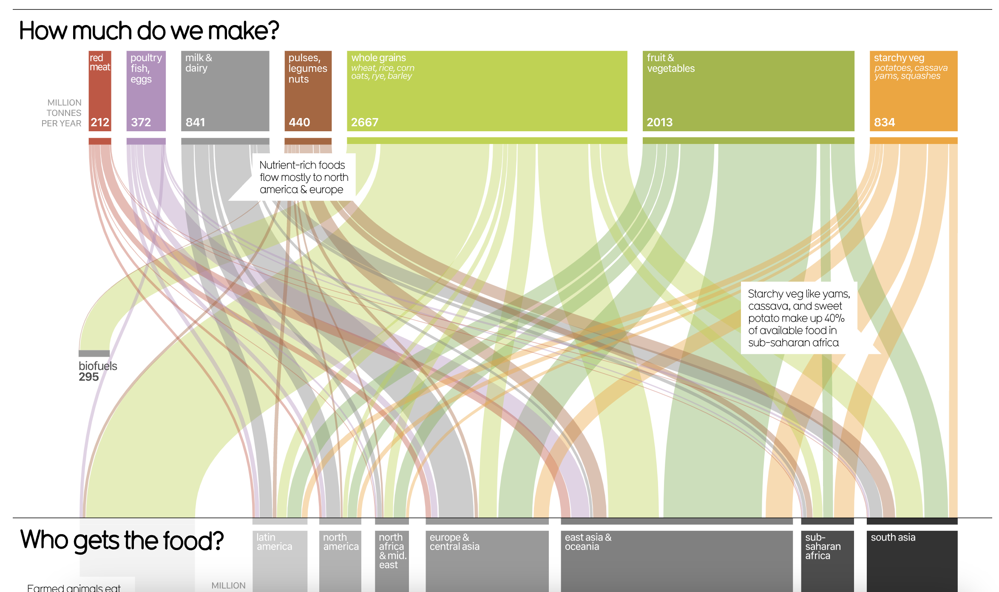
Does it help you explore?
https://informationisbeautiful.net/visualizations/global-food-supply-where-does-all-the-worlds-food-go/

Slide 9

Does it tell a story?
Hans Rosling’s 200 Countries, 200 Years, 4 Minutes – The Joy of Stats – BBC Four
https://www.youtube.com/watch?v=jbkSRLYSojo

Slide 10
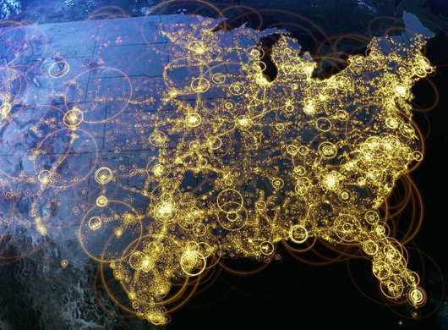
Visualization (def.)
Visual representations of data that reinforce human cognition
Notes:
Image from StackOverflow: http://i.stack.imgur.com/hbO8v.jpg

Slide 11
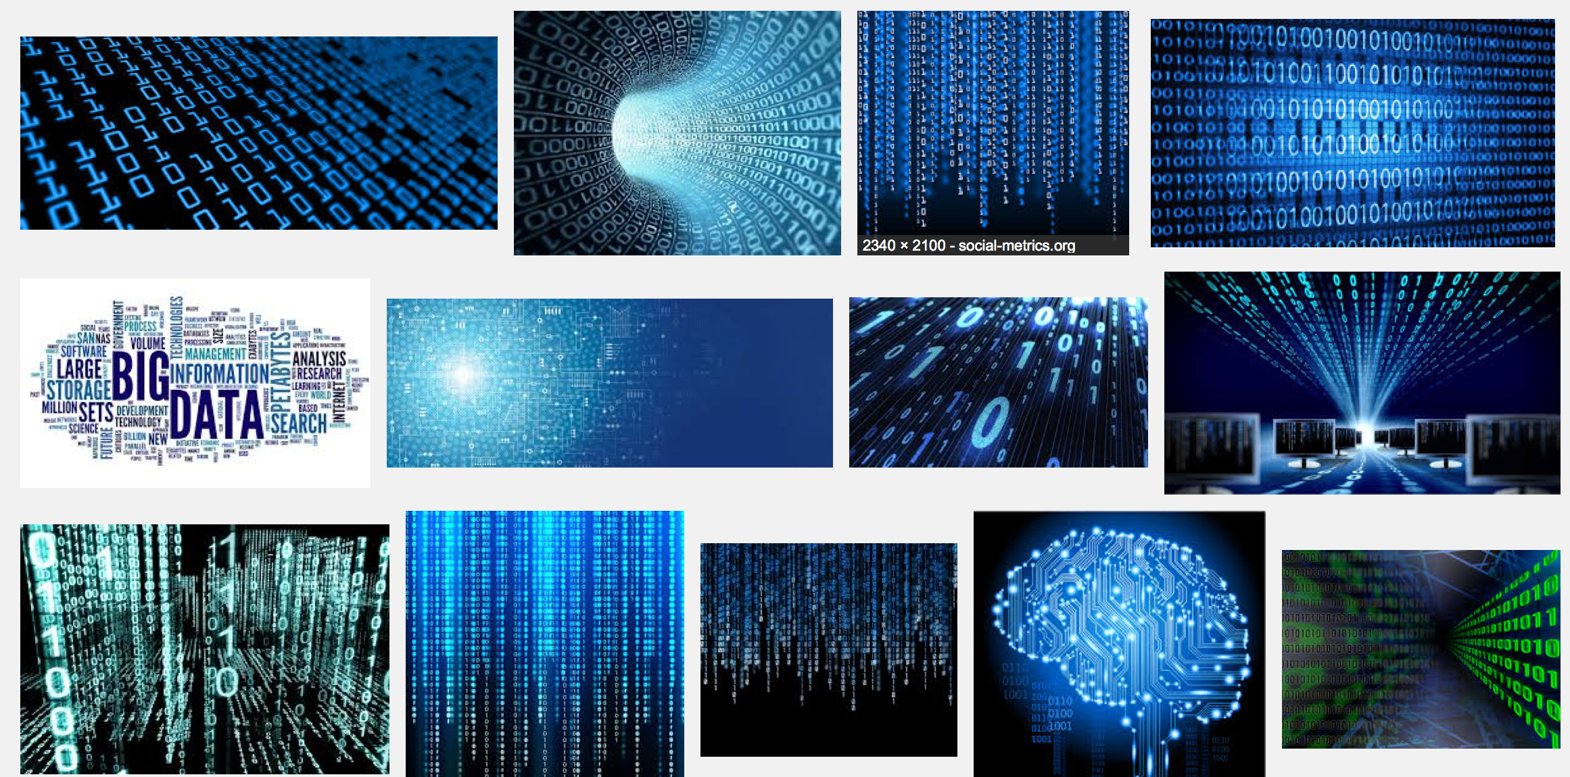
Wait… what is “data”?

Slide 12

Data: a definition
Data is a set of variables that capture various aspects of the world:
Tuition rates,
enrollment numbers,
public vs. private, etc.

Slide 13

Data: a definition
A dataset also contains a set of observations (also called records) over these variables. For example:
tuition = $46,288,
enrollment = 2,563,
private, etc.

Slide 14
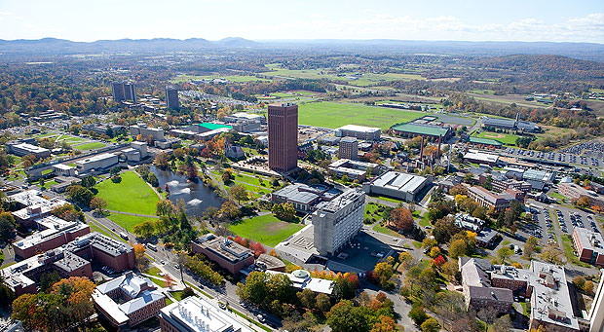

A dataset also contains a set of observations (also called records) over these variables. For example:
Data: a definition
tuition = $16,115,
enrollment = 28,635,
public, etc.

Slide 15
One way to think about this:
VARIABLES
 | Tuition | Enrollment | Public vs. Private | …
Smith College | $46,288 | 2,563 | private
UMass Amherst | $16,115 | 28,635 | public
Hampshire College | $48,065 | 1,400 | private
Mount Holyoke College | $43,886 | 2,189 | private
Amherst College | $50,562 | 1,792 | private
⋮
OBSERVATIONS

Slide 16
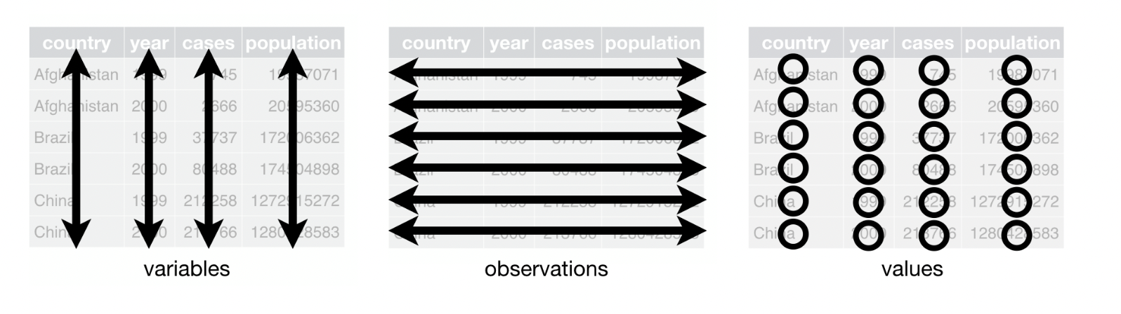
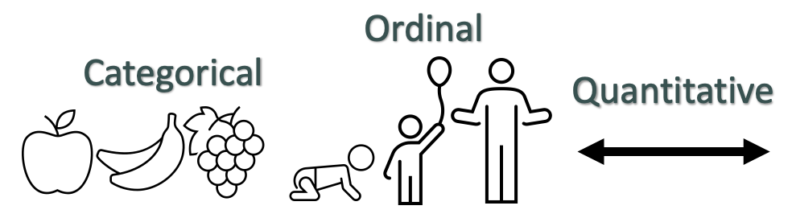
Data
Remember…

Slide 17
Data → Visuals
Remember…
Big idea behind visualization
Data have dimensions
Visualizations have dimensions, too
To build good visualizations, we need to map data dimensions to visual dimensions in a principled way

Slide 18
Data → Visuals
Remember…
Big idea behind visualization
Data have dimensions
Visualizations have dimensions, too
To build good visualizations, we need to map data dimensions to visual dimensions in a principled way

Slide 19
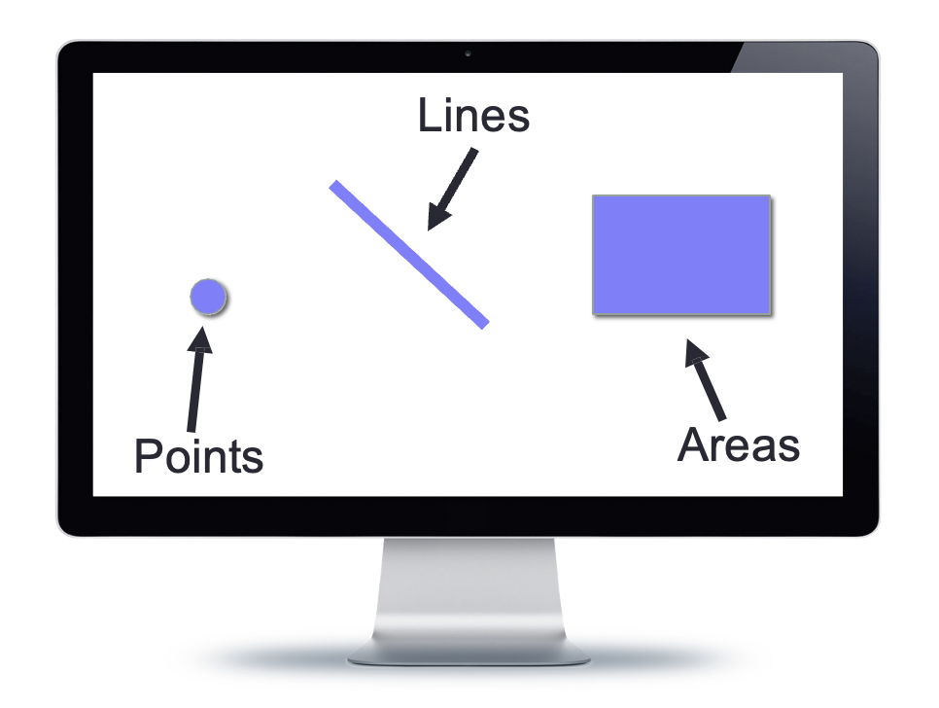
Data → Visuals
Data
Visuals
Marks
The “ink”

Slide 20
Data → Visuals
Data
Visuals
Marks
The “ink”
Channels or dimensions
How the marks show up on the page

Slide 21
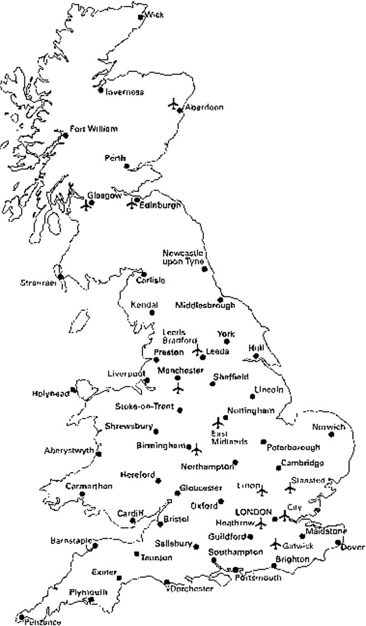
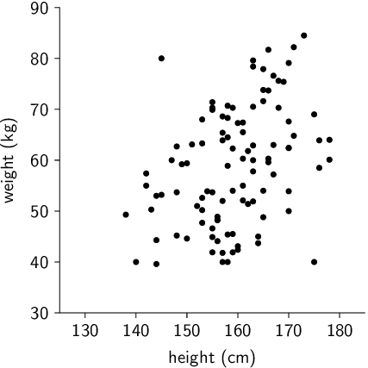
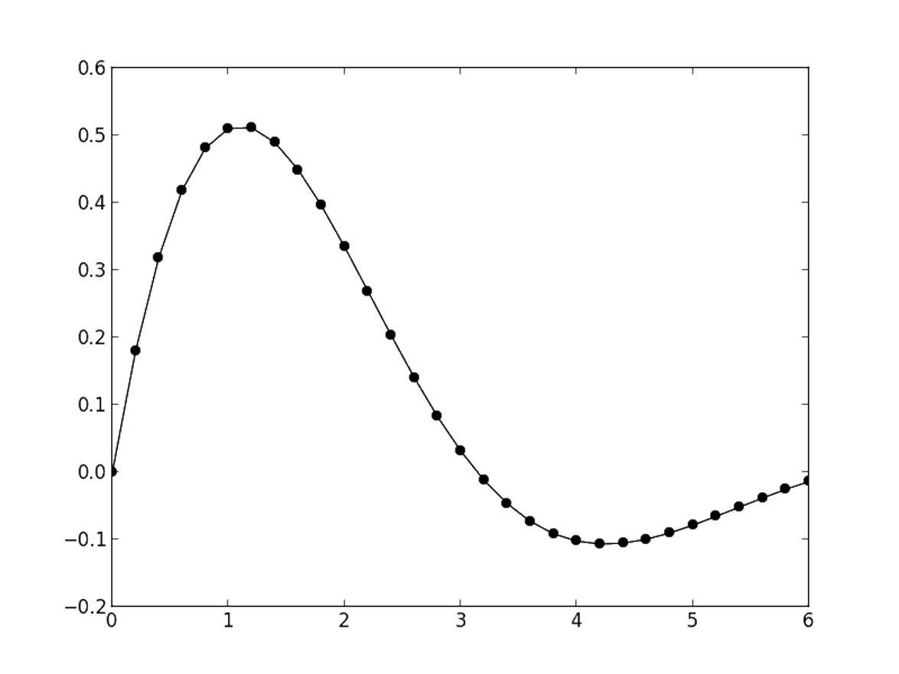
Visual Channels / Dimensions
Position
Encode information using where mark is drawn
Ex.

Slide 22
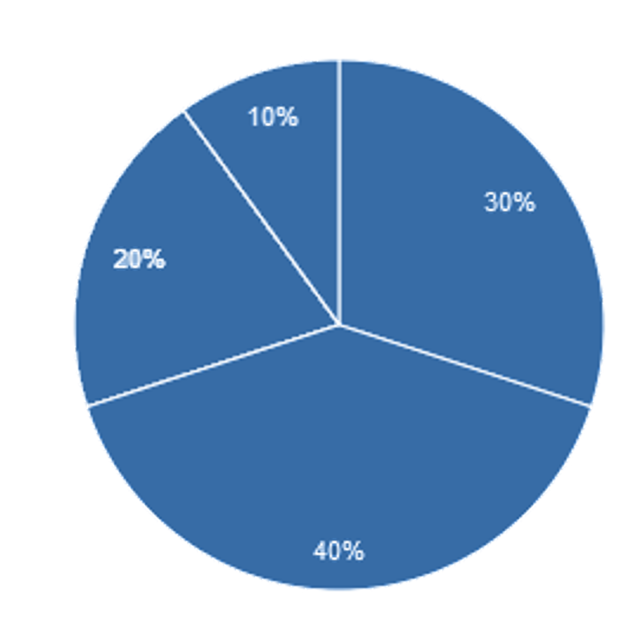
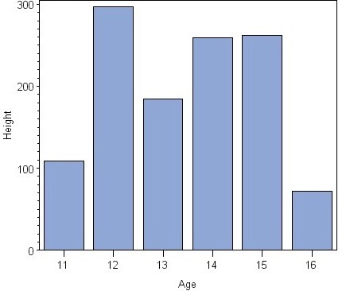
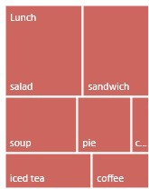
Visual Channels / Dimensions
Size
Encode information using how big mark is drawn
Ex.

Slide 23
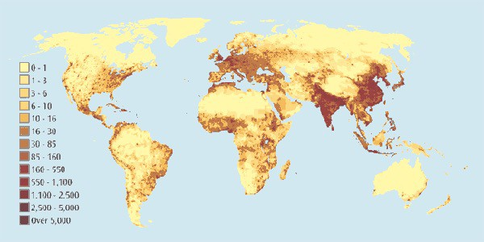
Visual Channels / Dimensions
Value
Encode information using how dark mark is drawn
Ex.

Slide 24
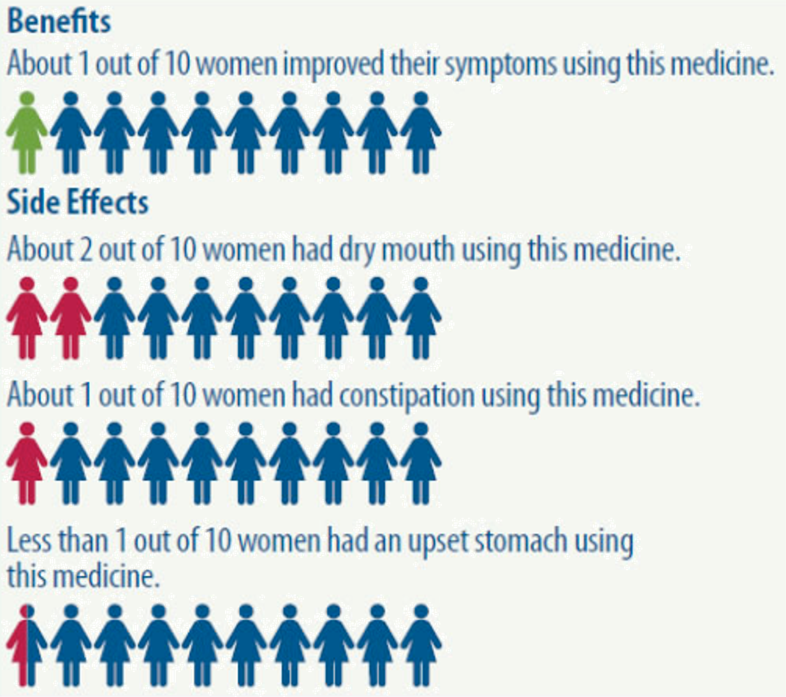
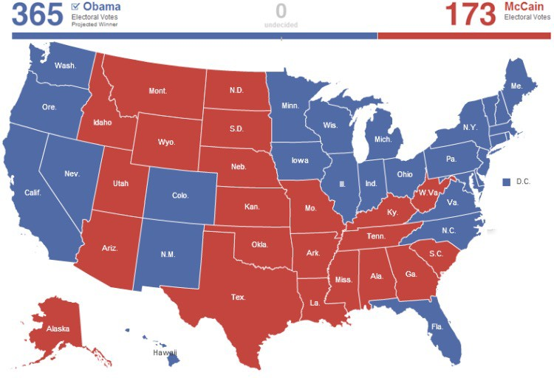
Visual Channels / Dimensions
Color
Encode information using hue of mark
Ex.

Slide 25
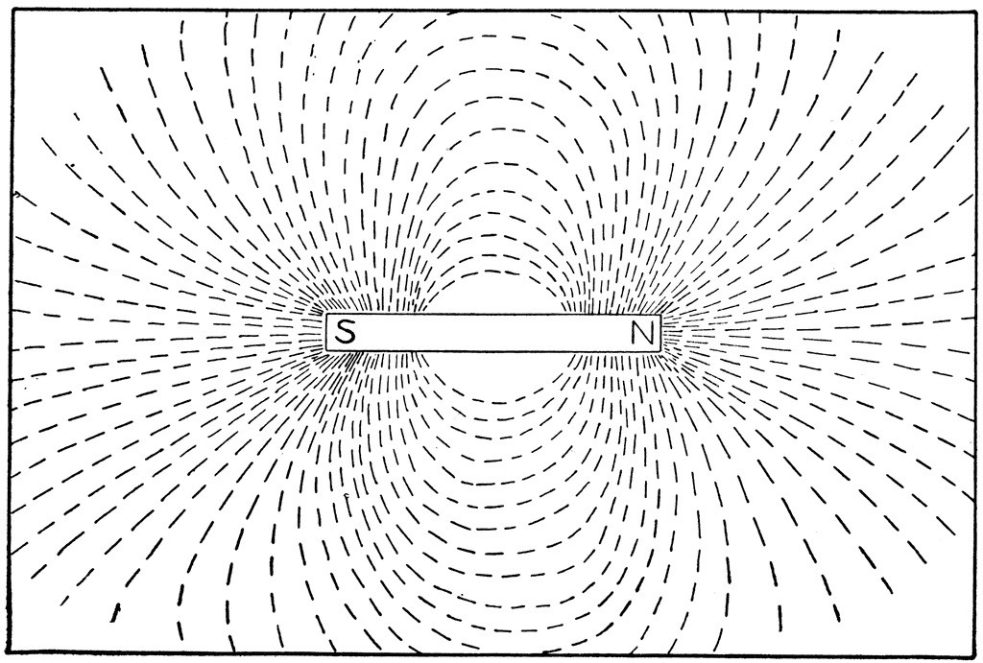
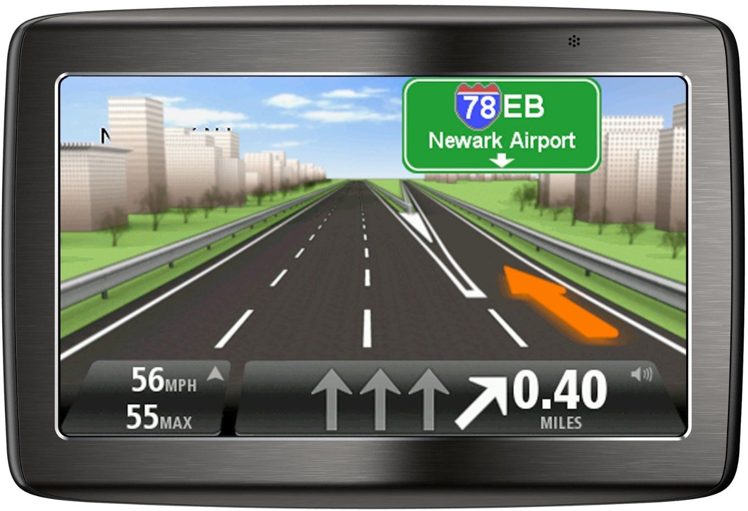
Visual Channels / Dimensions
Orientation
Encode information using how mark is rotated
Ex.

Slide 26



Visual Channels / Dimensions
Shape
Encode information using how mark is shaped
Ex.

Slide 27
Data → Visuals
Remember… Big idea behind visualization
Map data dimensions to visual dimensions in a principled way

Slide 28
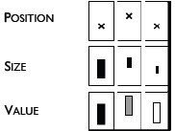

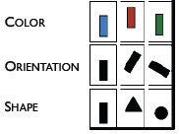
Data → Visuals
Remember… Big idea behind visualization
Map data dimensions to visual dimensions in a principled way

Slide 29
Data → Visuals
Remember… Big idea behind visualization
Map data dimensions to visual dimensions in a principled way
Let’s experiment. Pair up with 2 other people for the next activity and find a spot on the board.

Slide 30
Data → Visuals
Work with your group to represent each observation in this dataset as a point (mark) styled according using the visual channel you were assigned.
Be prepared to share with the class.
Name
blueberry
asparagus
pumpkin

Slide 31
Data → Visuals
What type of variable is Name?
Name
blueberry
asparagus
pumpkin

Slide 32
Data → Visuals
Work with your group to represent each observation in this dataset as a point (mark) styled according using the visual channel you were assigned.
Be prepared to share with the class.
Season
summer
spring
fall

Slide 33
Data → Visuals
What type of variable is Season?
Season
summer
spring
fall

Slide 34
Data → Visuals
Work with your group to represent each observation in this dataset as a point (mark) styled according using the visual channel you were assigned.
Be prepared to share with the class.
Price (per lb)
6.45
4.99
0.24

Slide 35
Data → Visuals
What type of variable is Price?
Price (per lb)
6.45
4.99
0.24

Slide 36

Data → Visuals
Remember… Big idea behind visualization
Map data dimensions to visual dimensions in a principled way
Not all visual dimensions can represent all data types
Jacques Bertin, Semiologie Graphique
(Semiology of Graphics), 1967.

Slide 37
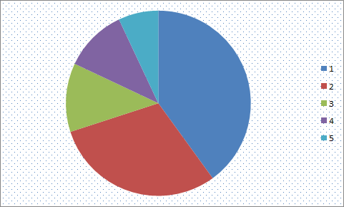
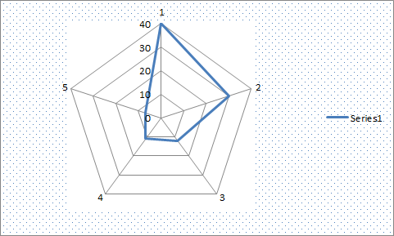
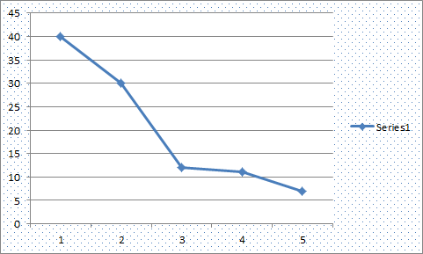
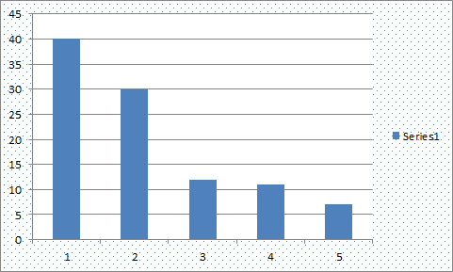
Key question for this course
Which data dimension should be mapped
to which visual dimension?

Slide 38
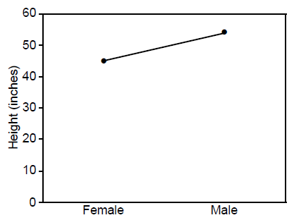
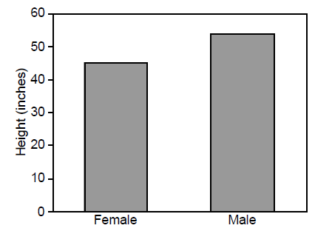
Answer: it depends
Average Height for Youth Sports Participants
Gymnastics Basketball
Gymnastics Basketball

Slide 39
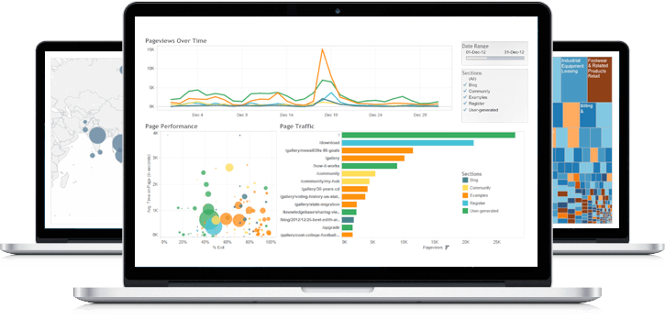
A sampling of visualization techniques

Slide 40
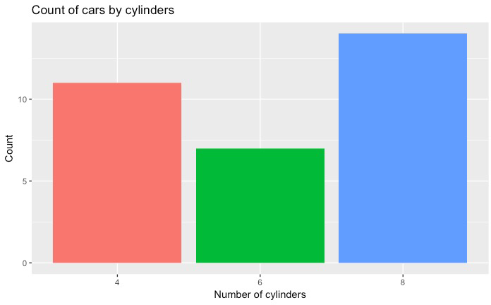
Used to show quantitative variable X categorical variable
Compares quantitative values for different categories
Highlights relative amounts
Grouped/stacked bars can break each category into sub-groups
Bar chart

Slide 41
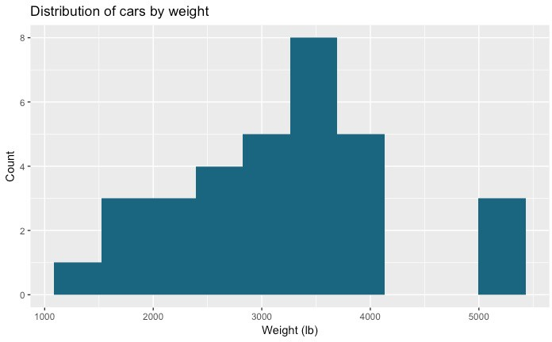
Used for one quantitative variable
Looks like a bar chart… but the x-axis consists of equal size ranges (bins) for the quantitative variable
Y-axis shows count or relative frequency
Highlights distribution
Note: bin size makes a big difference!
Histogram
10-14
25-29
45-49
50-54
20-24
30-34
40-44
15-19
35-39

Slide 42
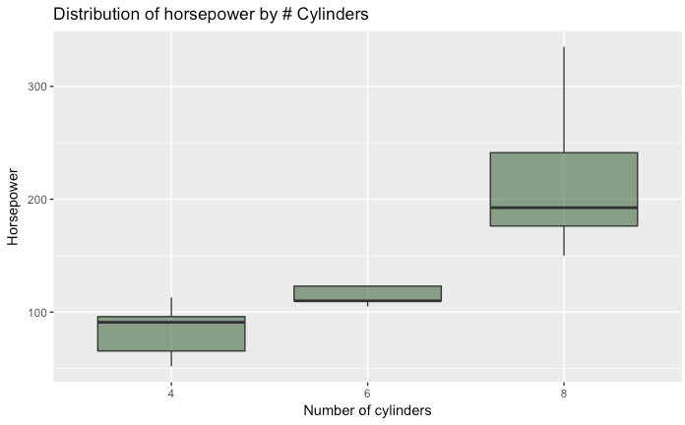
Used for one quantitative variable
Also useful for highlighting distribution
Calls out key values:
median
1st & 3rd quartiles
“fences”
outliers
Boxplot
“fence” (1.5IQR)
₃rd quartile
outlier
median
₁st quartile

Slide 43
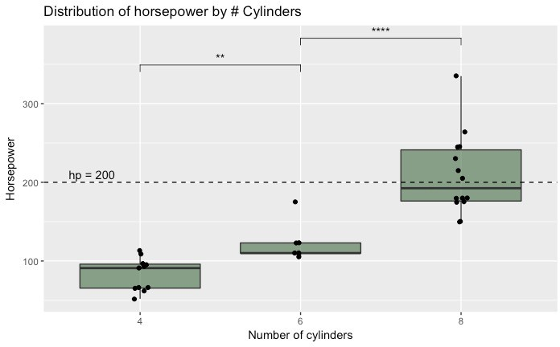
Use “jitter” to show actual values
Reference lines can help provide context
Can use annotations to show statistical significance
Boxplot

Slide 44
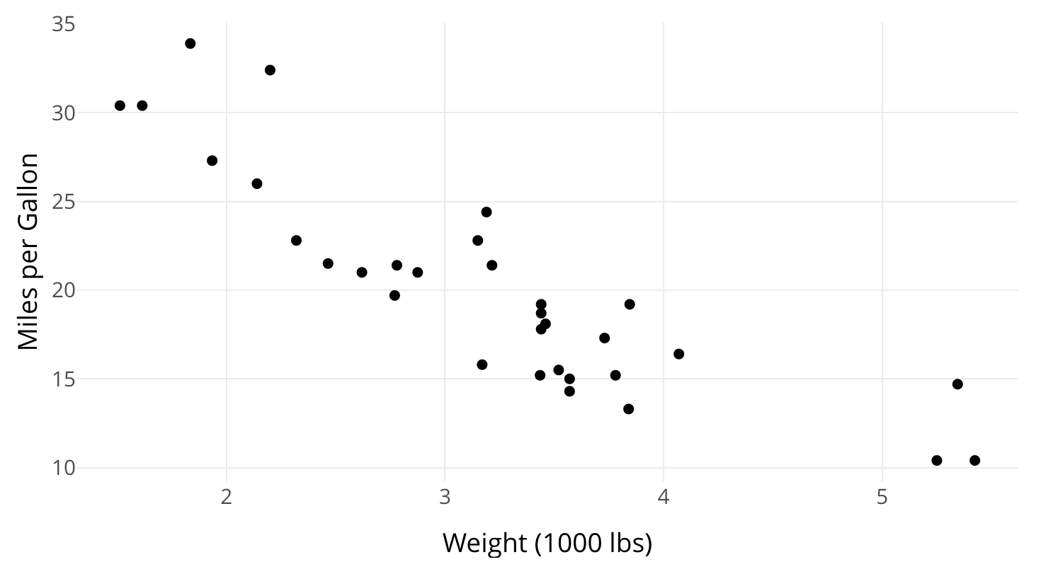
Used to show one quantitative variable X one quantitative variable
Shows the relationship between the two variables
Each point in the plot represents an observation
Scatterplot

Slide 45
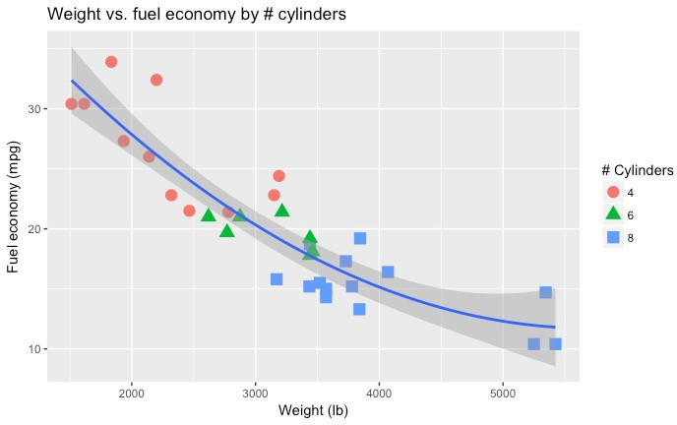
Can use color or symbol to show one quantitative variable X one quantitative variable X one categorical variable
This highlights groups
Sometimes useful to show a trend line (regression)
Scatterplot

Slide 46
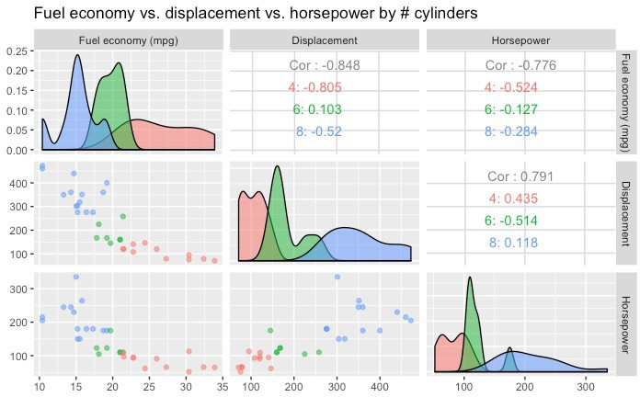
Can use to show many combinations of one quantitative variable X one quantitative variable
Combines multiple scatterplots into a matrix to show additional relationships
Scatterplot matrix (SPLOM)

Slide 47
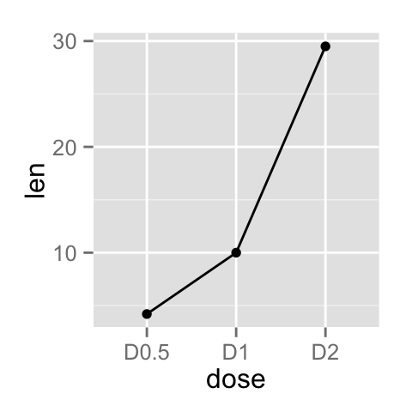
Shows the trend of one quantitative variable, often over time
Line chart

Slide 48
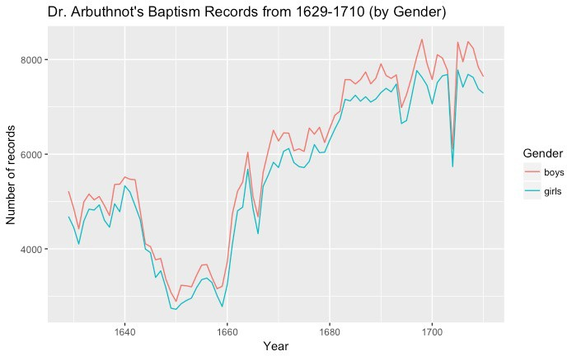
Multiple lines allow comparison of trends
Can show one quantitative variable across groups, or multiple quantitative variables (if they have the same scale)
Highlights “position switches”
Line chart

Slide 49
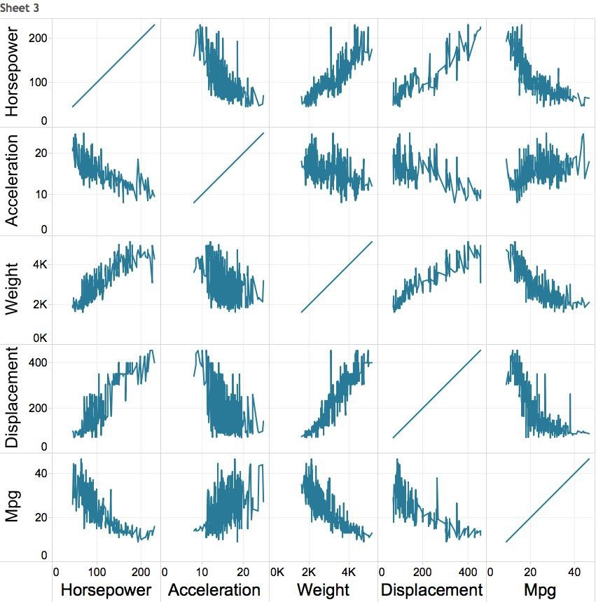

Multiple variables: line chart matrix?

Slide 50
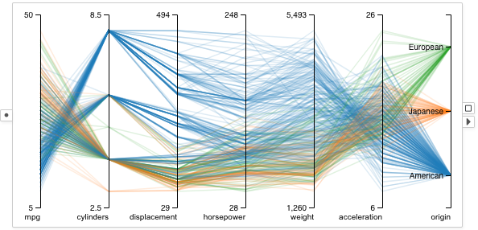
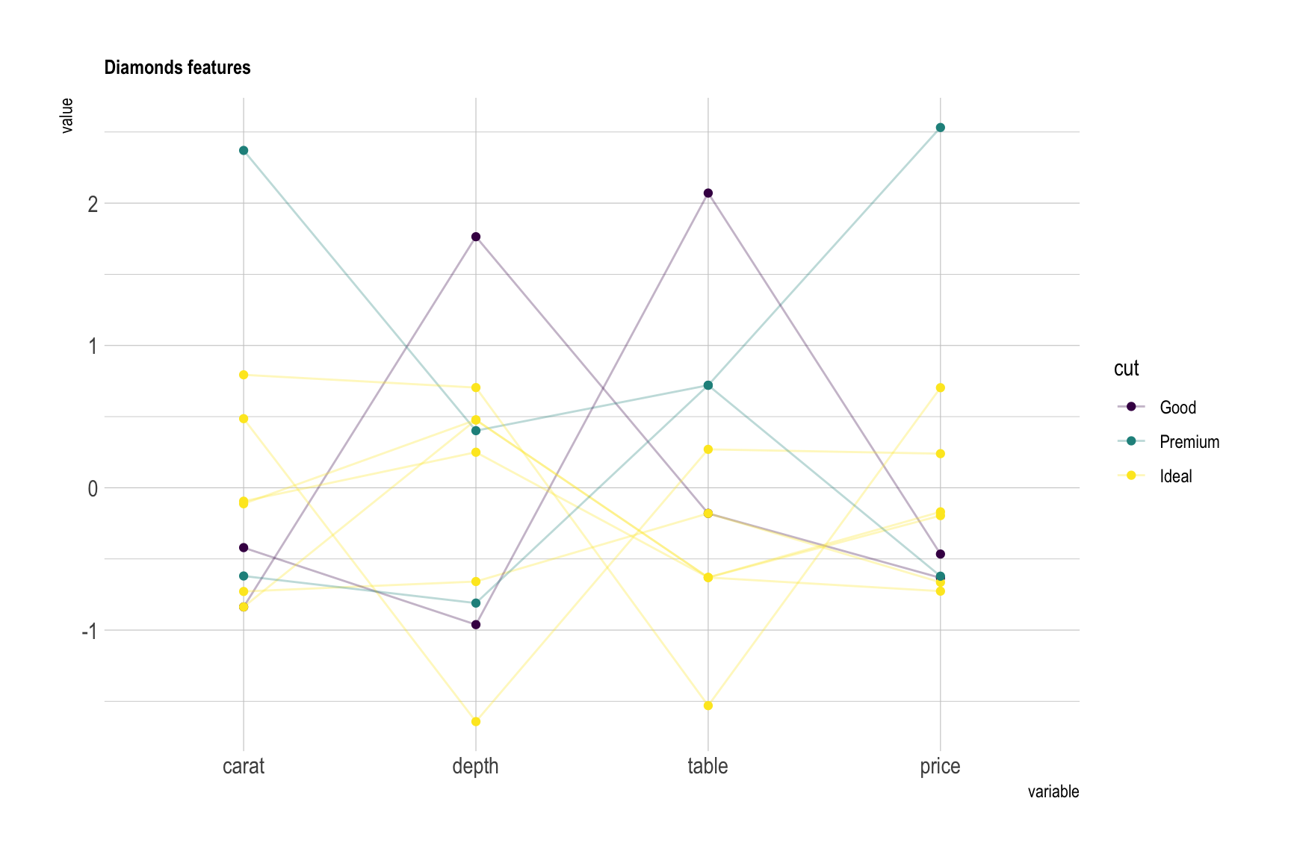
Supports (pairwise) comparison of a collection of quantitative variables
Each axis represents one variable
They may have different scales, typically you normalize them
Each line represents one observation (connecting the associated values along each axis)
Axis order matters!
Parallel Coordinates Plot
https://visflow.org/node/visualization/parallel-coordinates.html
https://www.data-to-viz.com/graph/parallel.html

Slide 51
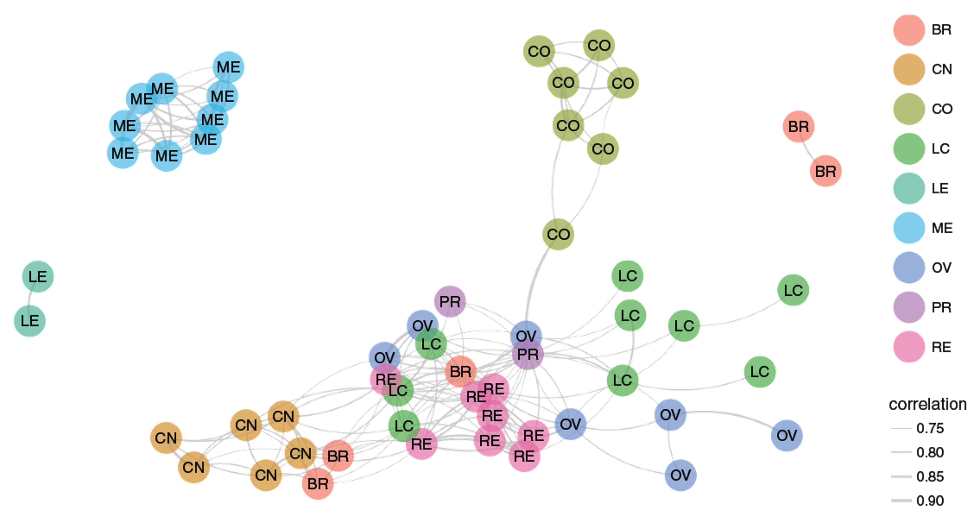
Shows graph data
Useful for showing the relationships between entities
Can use color, size, etc. to encode additional information
Caveat: network diagrams quickly become hairballs for large, dense data
Network

Slide 52
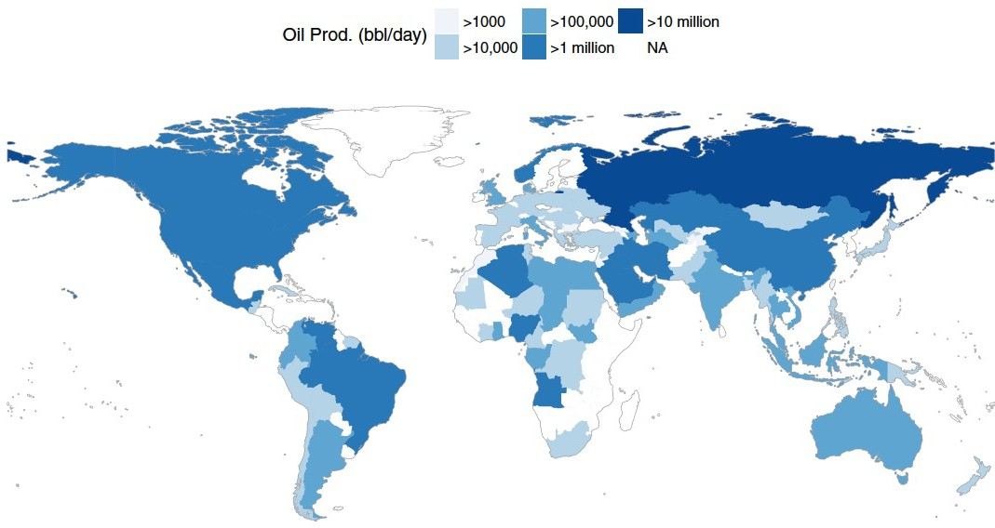
Shows geographic (spatial) data
Useful for analysis with a strong geographic component
Filled maps (choropleth) vs. points
Remember: color scale comparisons are harder for humans than size comparisons!
Map

Slide 53
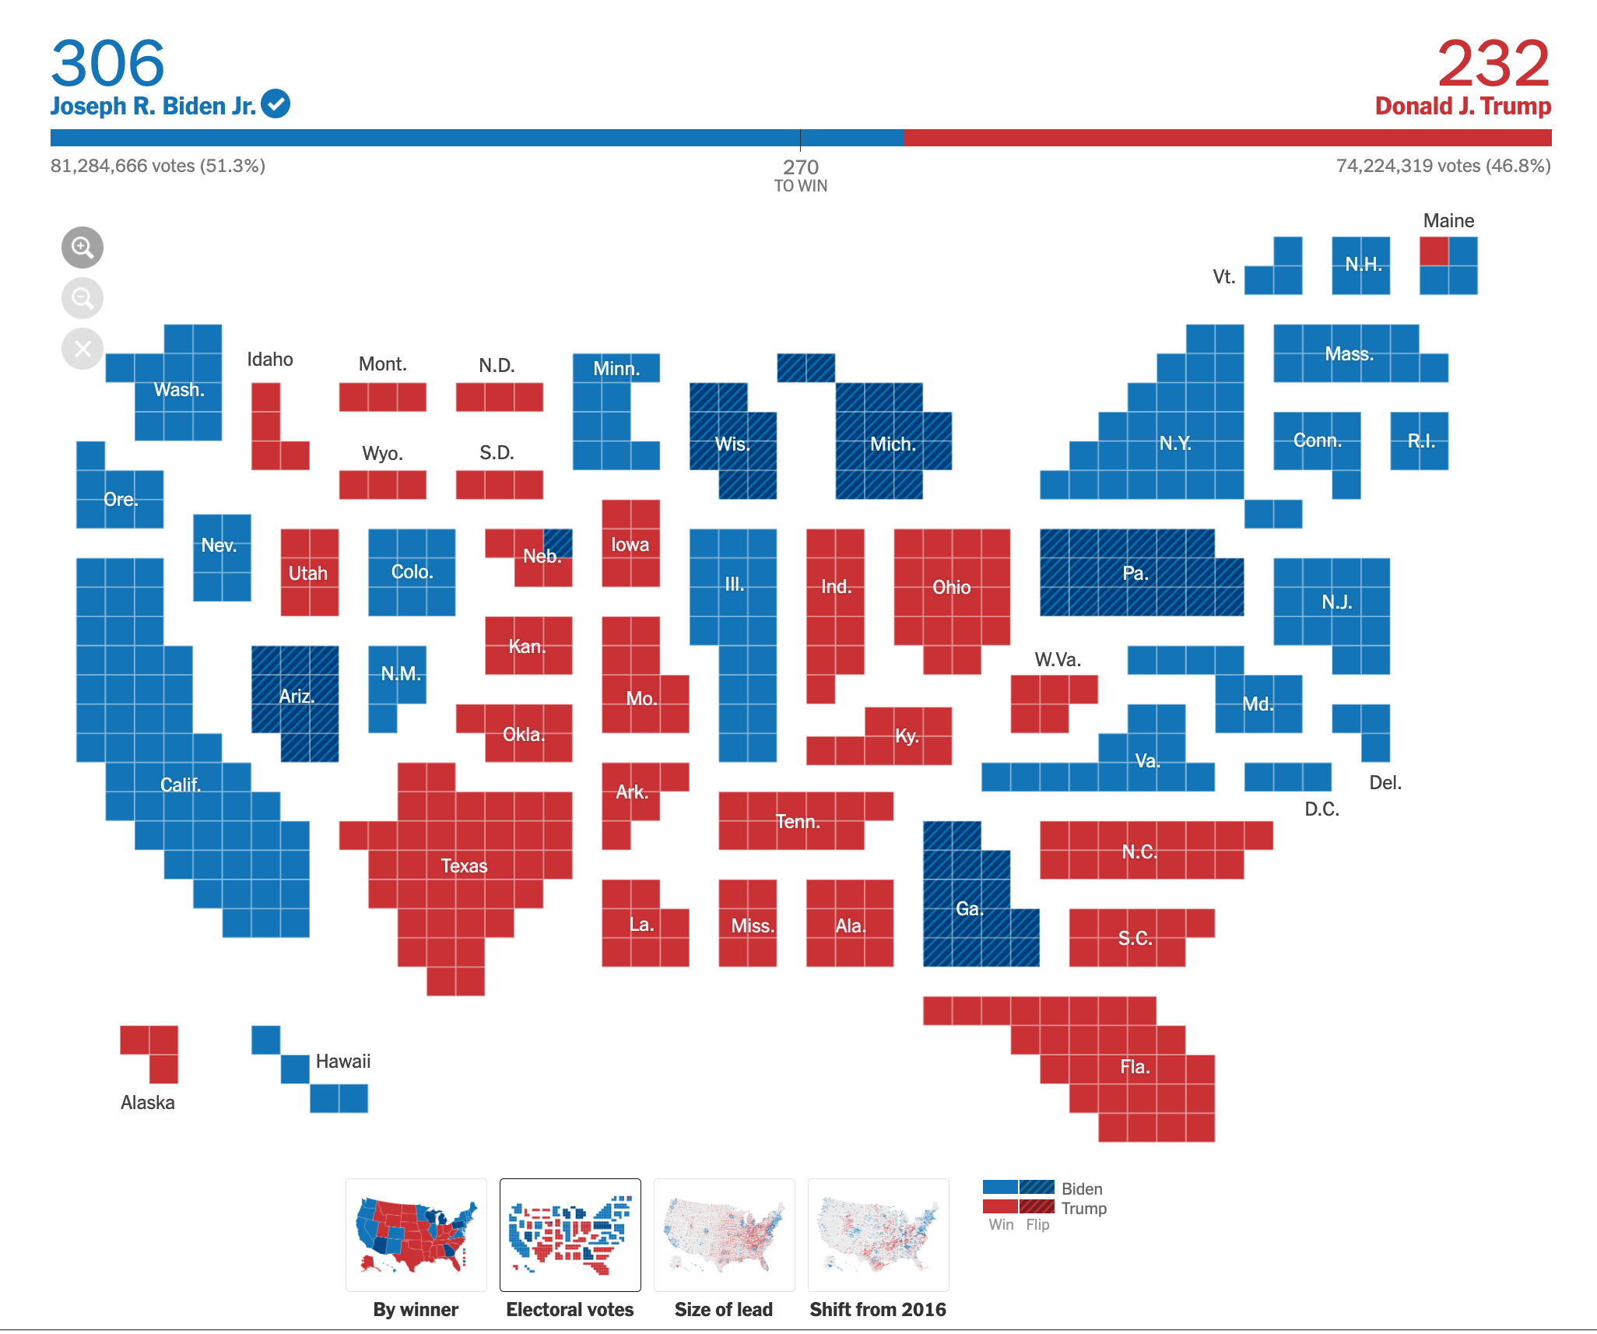
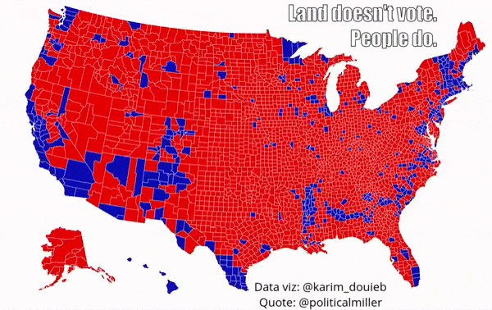
Remember to map the correct data to your visual channels
Map

Slide 54
Questions?

